Slide 1
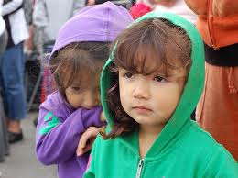
Hunger and Poverty in Our Schools: What We Can Do?
Suzanne M. Martin, Ph.D.
Professor

Slide 2
Share Our Strengths 2012 Report
Hungry kids can’t learn
80% of those who see hunger say kids are coming to school hungry at least one day a week
3 in 5 K-8 public school teachers say students regularly come to school hungry
65% of America's teachers regularly see kids who come to school hungry because they aren't getting enough to eat at home.

Slide 3
Share Our Strengths 2012 Report http://www.nokidhungry.org/about-us
Issues with hunger:
Can’t concentrate
Poor academic performance
Headaches
Stomach aches
Behavior problems
Lethargy

Slide 4
No Kid Hungry NoKidHungry.org
78% of teachers are spending on average $26 a month on food for the students in their classrooms
9 of 10 teachers say breakfast is extremely important
At least 20 million low-income students ate free or reduced lunch in 2011
Eccleston all children get free breakfasts

Slide 5
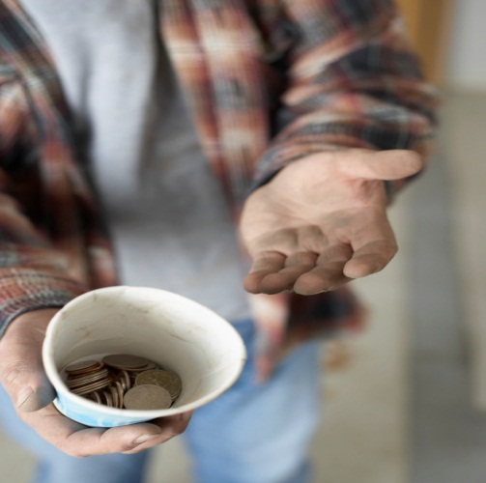
Number of hungry children increases
the number of Americans on food stamps has increased from 34 million to 42 million.
the number of Americans on food stamps has increased from 34 million to 42 million.
http://www.cbn.com/cbnnews/us/2010/November/Actor-Jeff-Bridges-Wants-No-Kids-Hungry/

Slide 6
What can we do?
Create the world in which we want to live
Take the pledge and help us fill the pantries of two schools
Volunteer to take food to a schools– please sign sheet
Volunteer to talk to other education organizations – please sign sheet

Slide 7
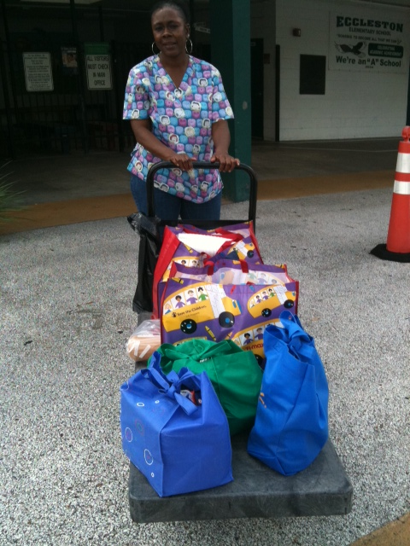
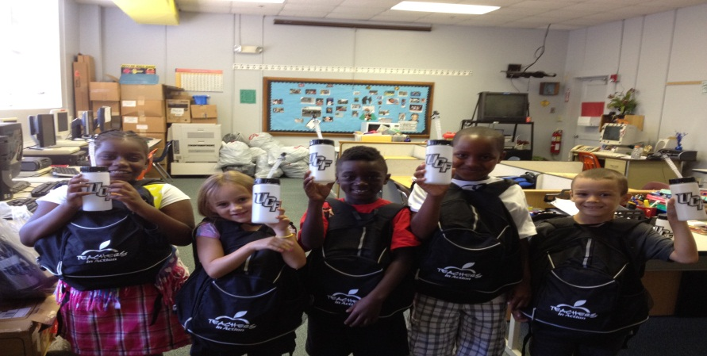
What can we do?
Volunteer to talk to other education classes – please sign sheet
Bring non-perishable food to the HUB in the TA
Host a fund raiser
Other ideas?

